Slide 1


.
Presentation
Topic : Smart desk AI bot
Group Members
Areeb 1269
Muntaha 1279
Amna Ashraf 1246
Bushra Fatima 1253
MominaHussain 1264

Slide 2


Liceria & Co.
FUNCTIONS:
Chatbot
Image Generator
Background Remover
Text Extractor
Song Finder
Audio generator
Sentiment Analyzer
QR Code Generator
URL Shortener
Image Colorizer
overview:
This project is basically a multifunctional ai bot. It will perform many functions related to artificial intelligence like image generation and image processing. It mainly consists of a menu where we can the AI functionality we want to perform. So, we will basically API calls and some libraries to perform necessary functionality.

Slide 3
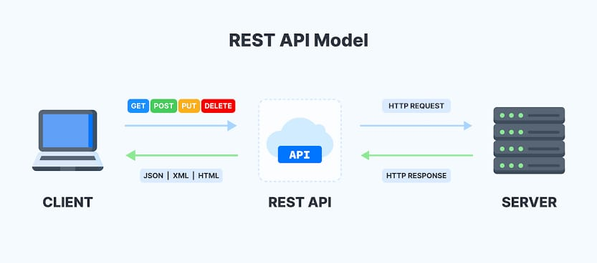
What is Api Calls ?
Application Programming Interface (API) provide a way for different applications to communicate with each other, and API calls are how one application interacts with another application's functionalities.

Slide 4
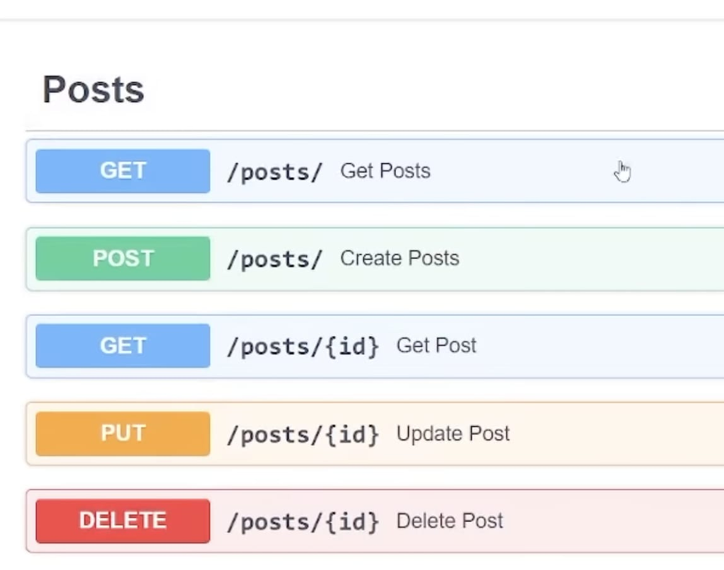
HTTP Method: The action you want to perform on the API. Common HTTP methods used in API calls include:
GET: Retrieve data from the server (e.g., get a list of users).
POST: Send data to the server (e.g., submit a new user).
PUT: Update data on the server (e.g., update user information).
DELETE: Remove data from the server.

Slide 5
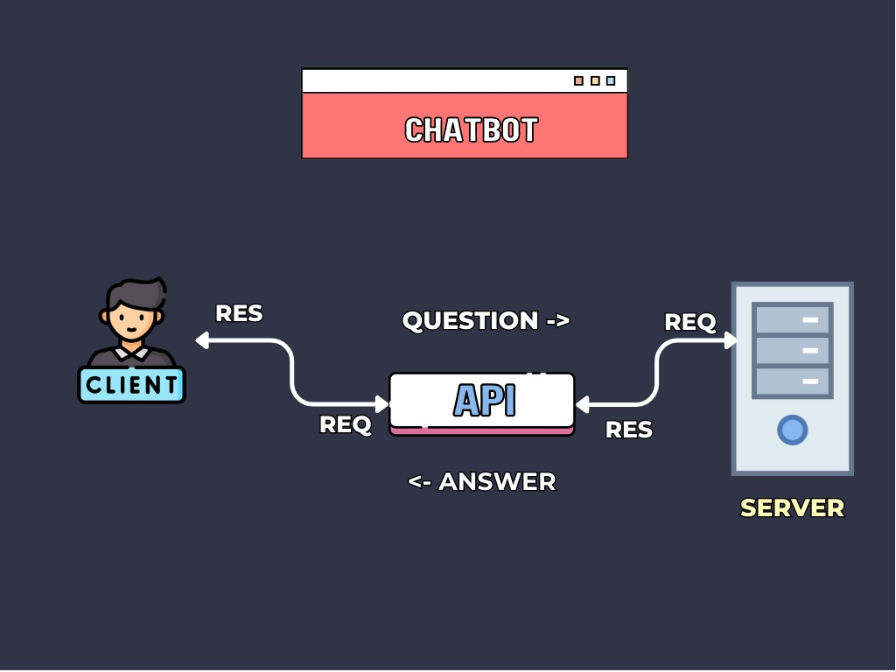
CHATBOT
A chatbot is a software application designed to simulate human conversation through text or voice interactions. It uses natural language processing (NLP) and artificial intelligence (AI) to understand user inputs and provide appropriate responses

Slide 6
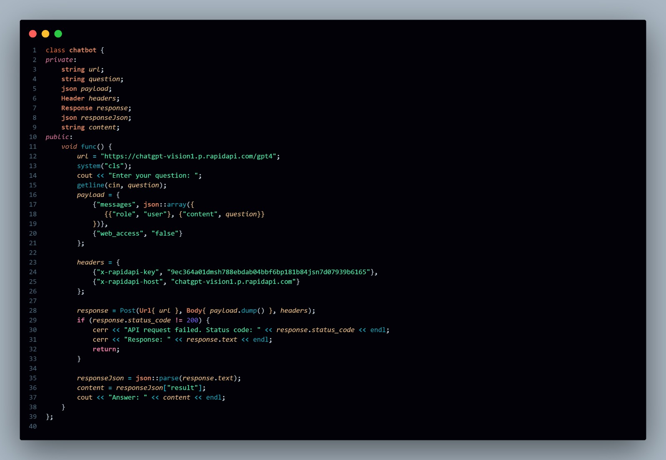

Slide 7
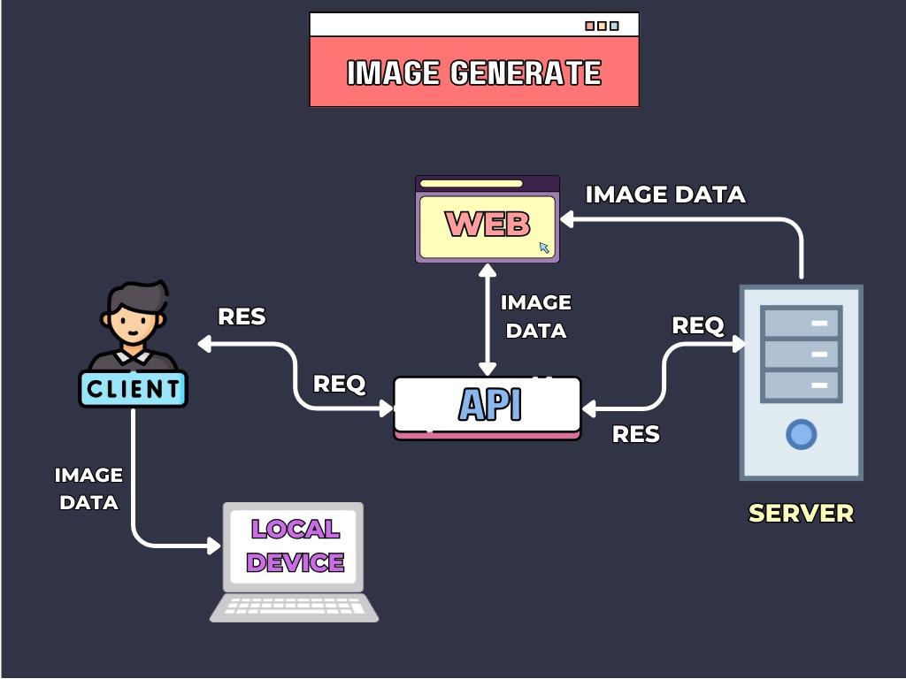
Image
generator
An image generator is a tool or software that uses artificial intelligence (AI) to create images based on textual descriptions, existing images, or other input forms

Slide 8
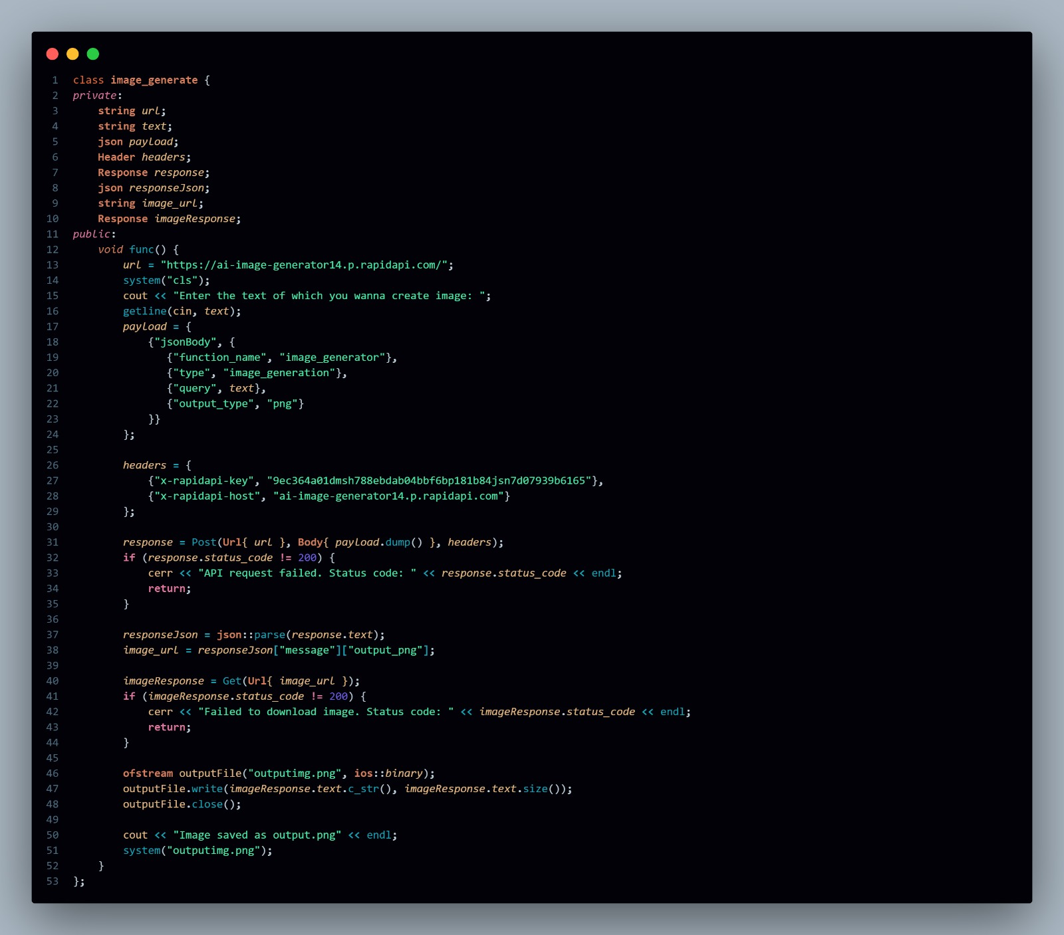

Slide 9
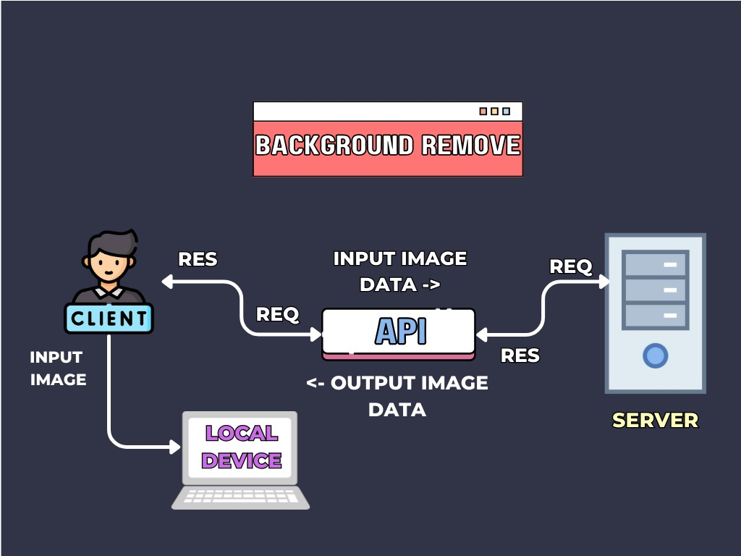
BACKGROUND REMOVER
A background remover is a tool or software that automatically removes or isolates the background from an image, leaving only the subject or object in the foreground.

Slide 10
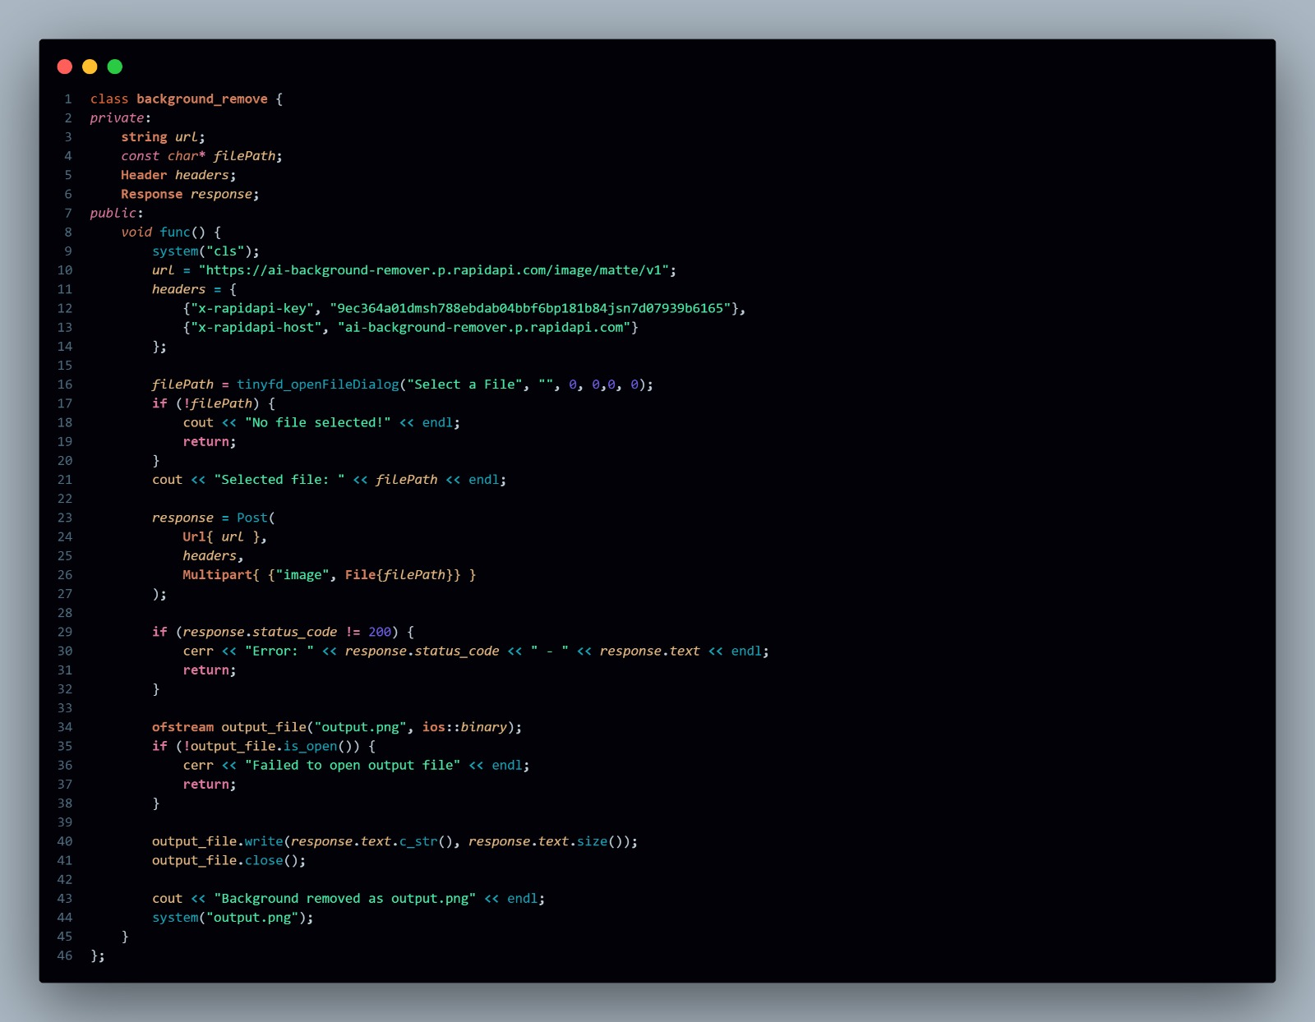

Slide 11


Text extractor
A text extractor is a tool or software that is used to extract text from various types of documents or media, such as images, PDFs, scanned documents, web pages, or other sources where text is not immediately accessible.

Slide 12
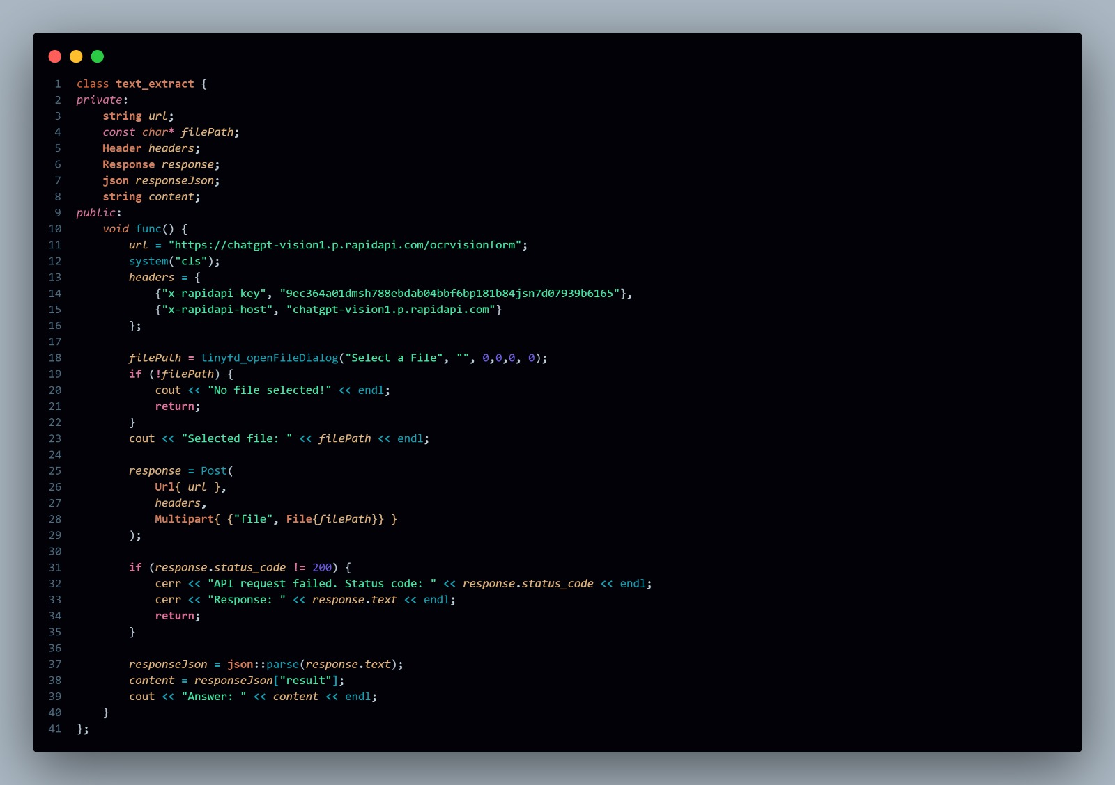

Slide 13
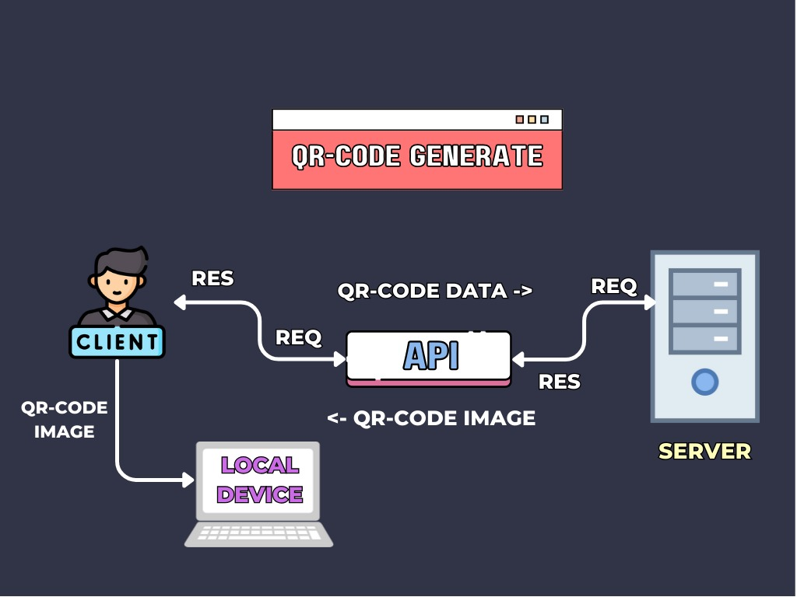
QR CODE
GENERATOR:
A QR code generator is a tool or software that creates QR codes (Quick Response codes) based on input data, such as text, URLs, contact information, or any other type of data.

Slide 14
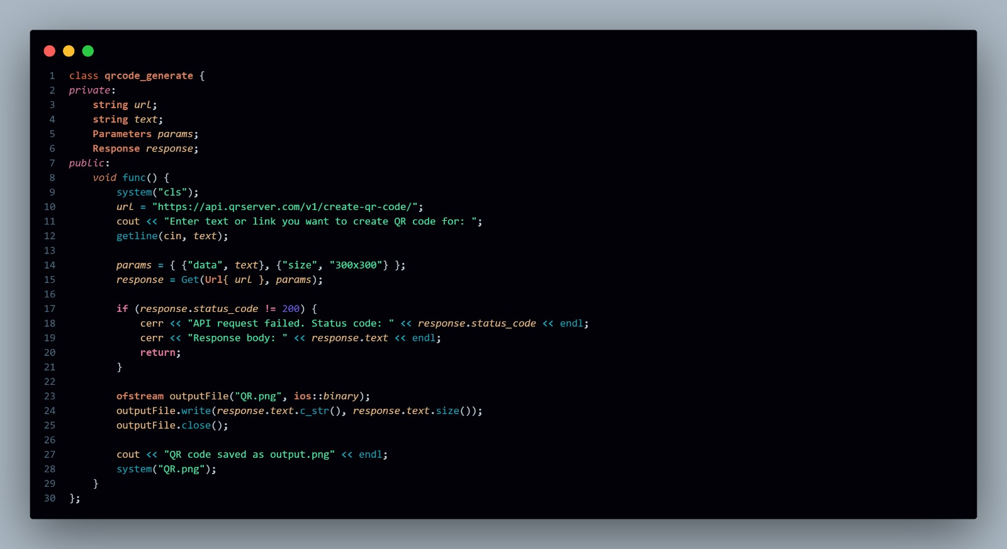

Slide 15

Song Finder:
A song finder is a tool or application that helps you identify a song based on various input sources, such as lyrics, melodies, or even audio snippets.

Slide 16
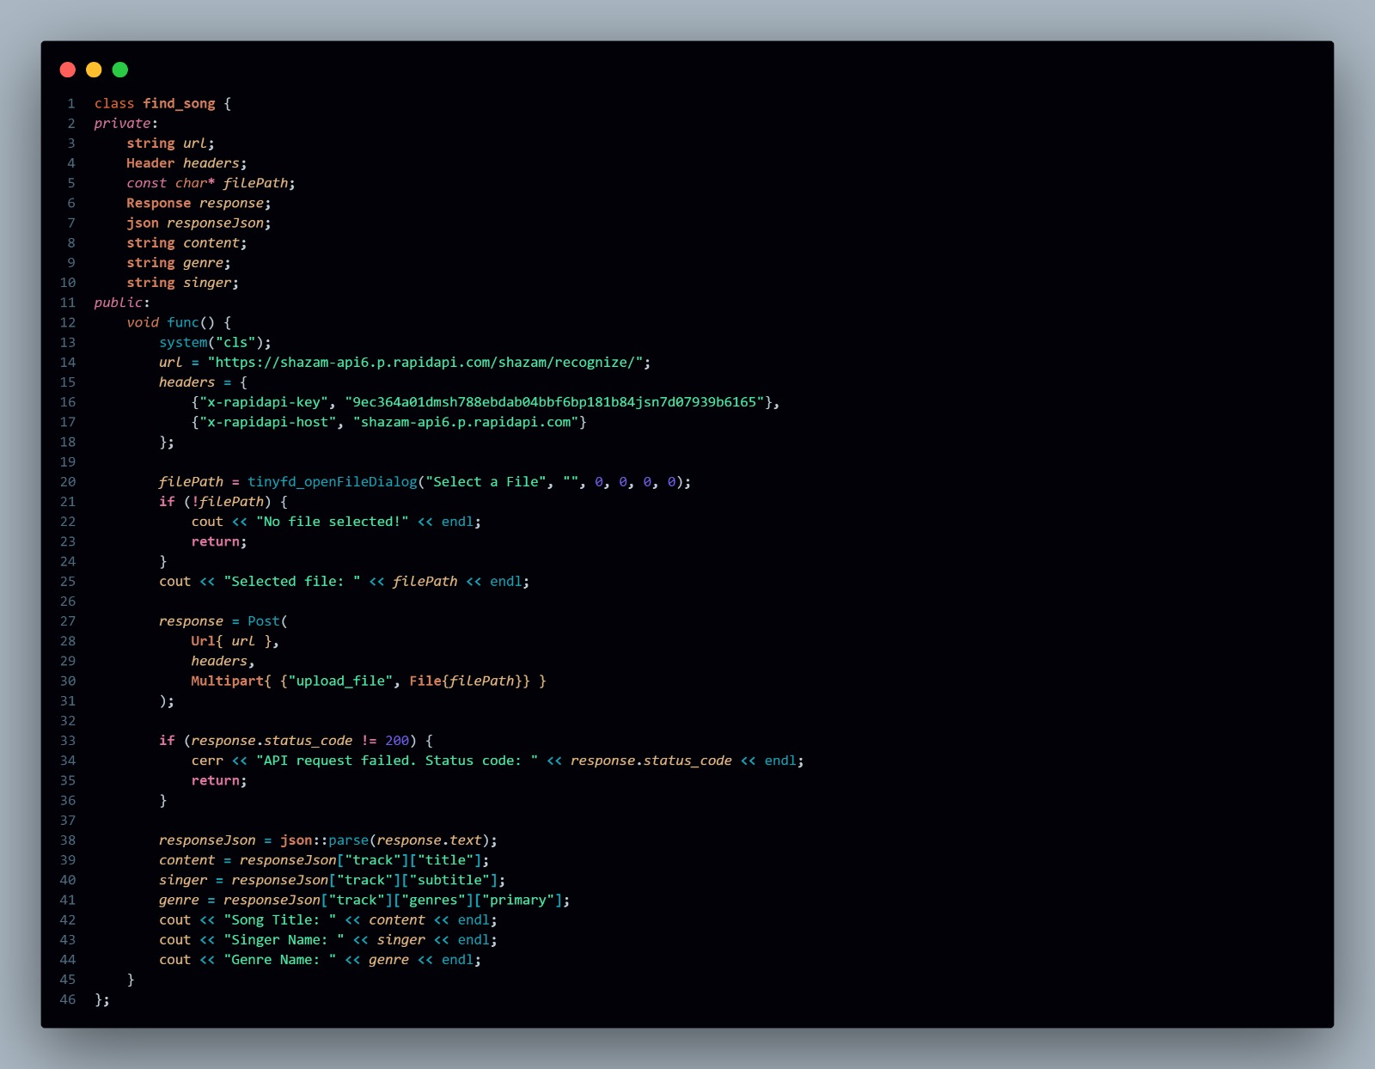

Slide 17

Audio Generator:
An audio generator is a tool or software that produces sound or audio based on specific inputs or parameters. These generators can create a wide variety of sounds, from simple tones to complex audio compositions.

Slide 18
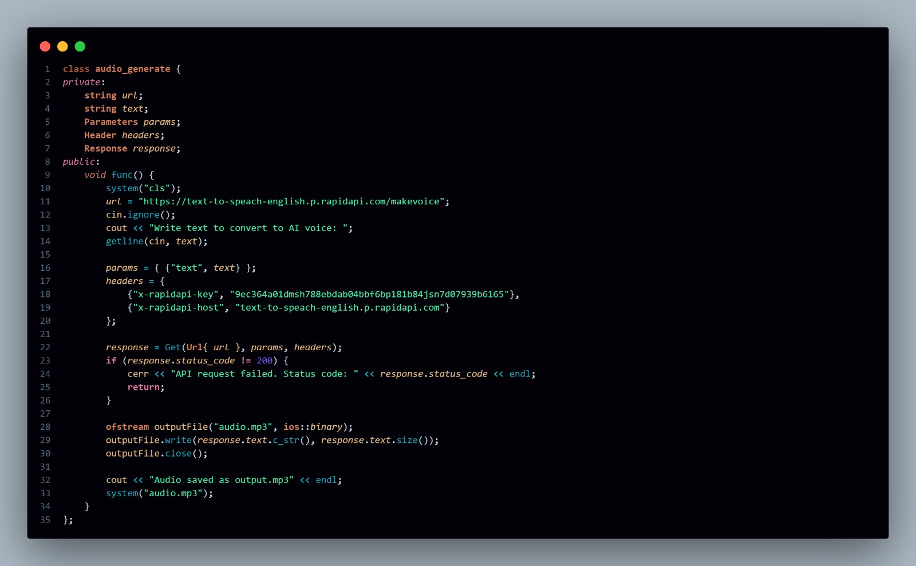

Slide 19
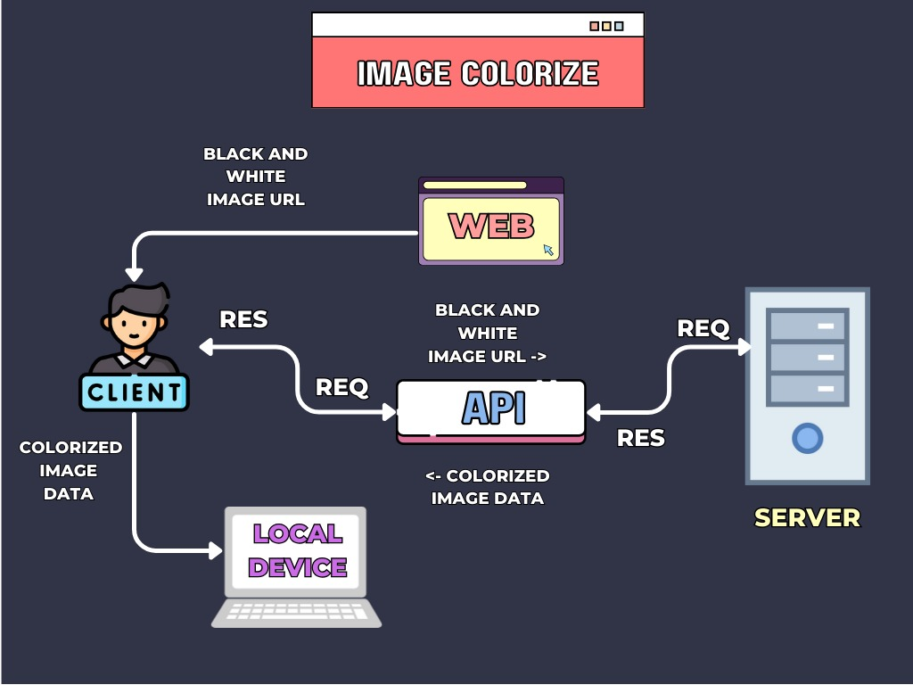
IMAGE COLORIZER:
An image colorizer is a tool or software that automatically adds color to black-and-white (grayscale) images. These tools use advanced techniques, including machine learning and deep learning, to predict and apply colors to different regions of an image.

Slide 20
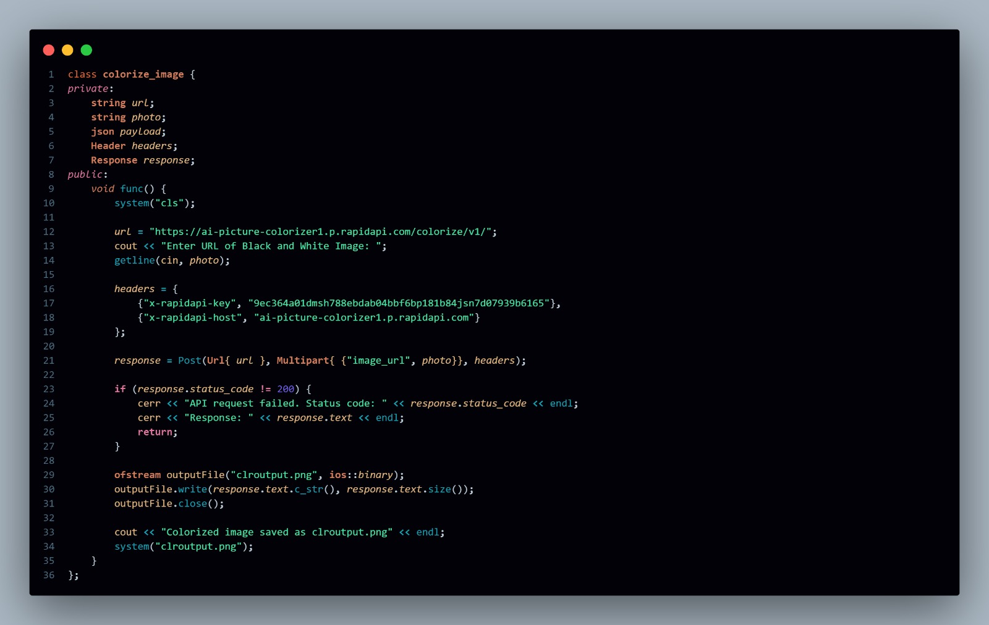

Slide 21
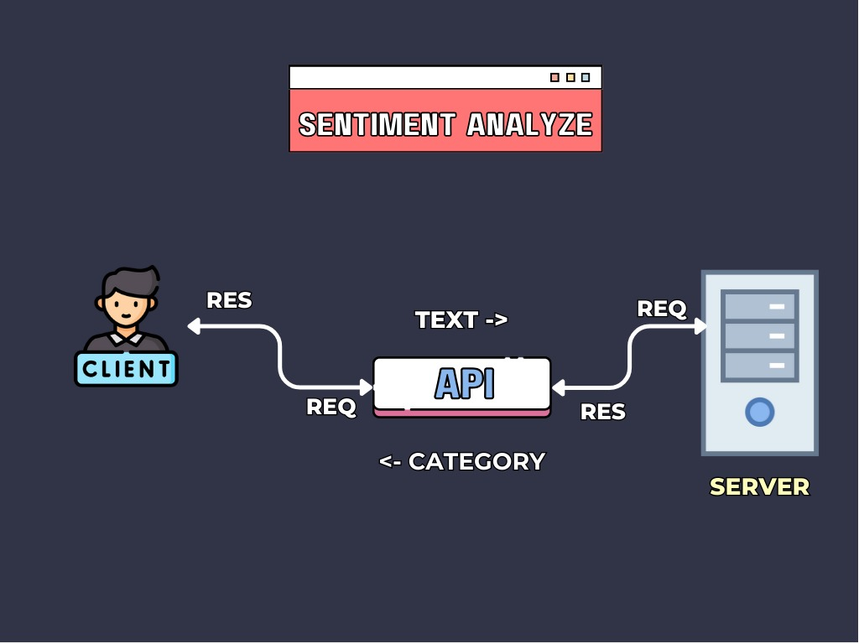
Sentiment Analyzer:
A sentiment analyzer (or sentiment analysis tool) is a software application or system that uses natural language processing (NLP) and machine learning techniques to determine and categorize the emotional tone behind a piece of text. It helps understand the sentiment expressed in the text—whether it’s positive, negative, neutral.

Slide 22
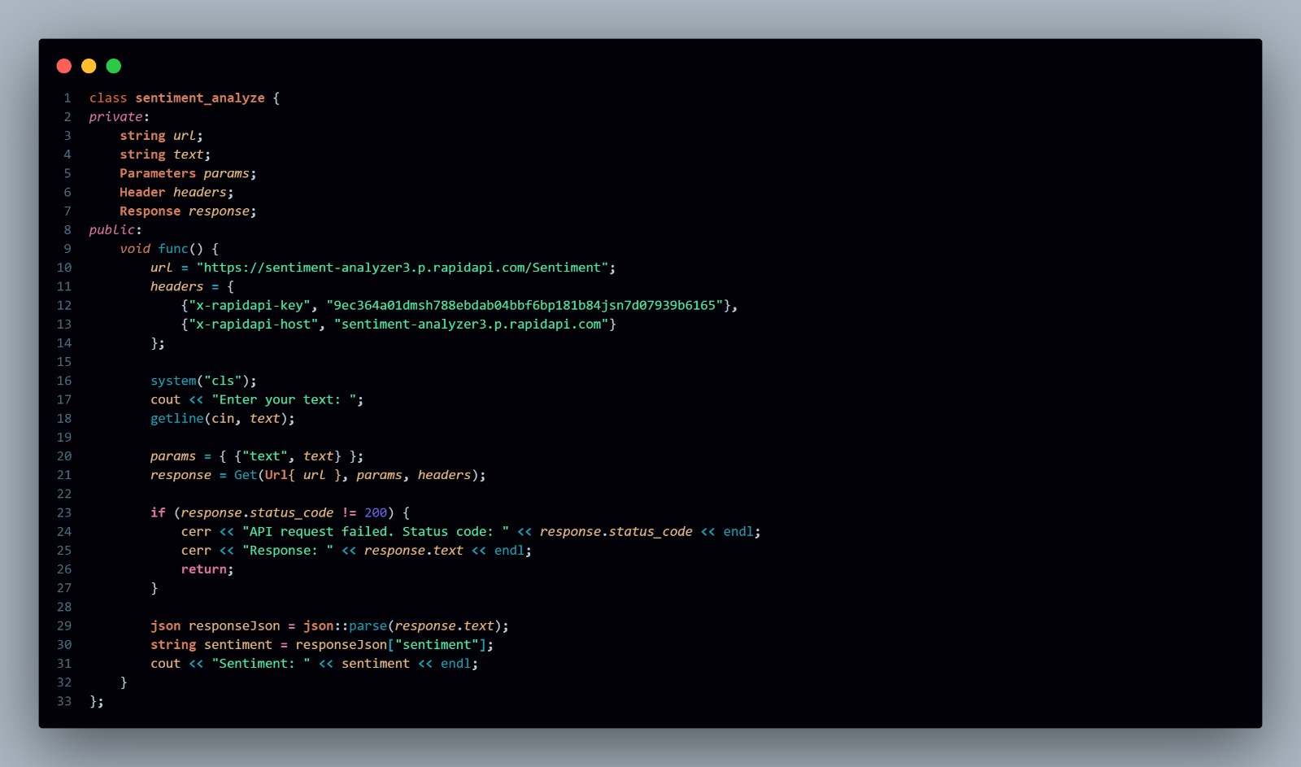

Slide 23
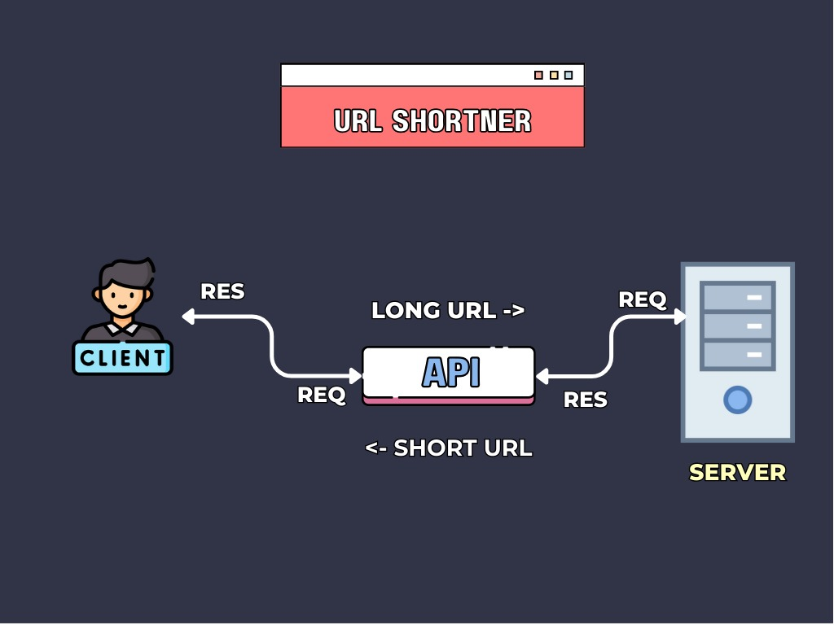
URL SHORTENER:
A URL shortener is a service that converts a long URL (web address) into a much shorter version, which redirects to the original URL. This is useful for sharing links more easily, especially on platforms with character limits (like Twitter), or when you want to make URLs more aesthetically pleasing or manageable.

Slide 24
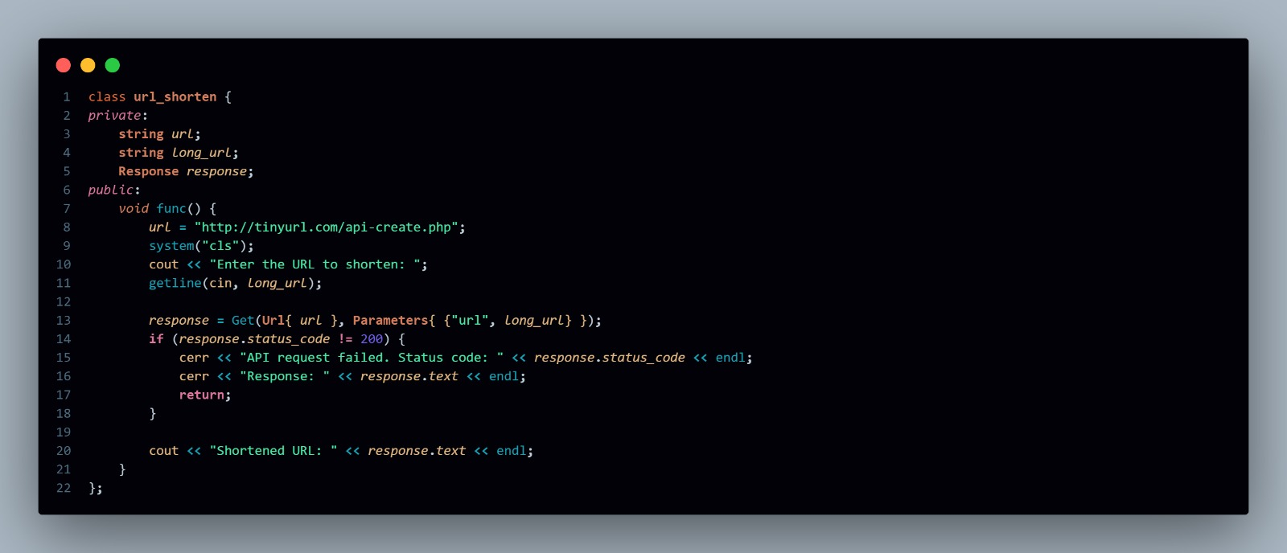
URL SHORTENER code

Slide 25
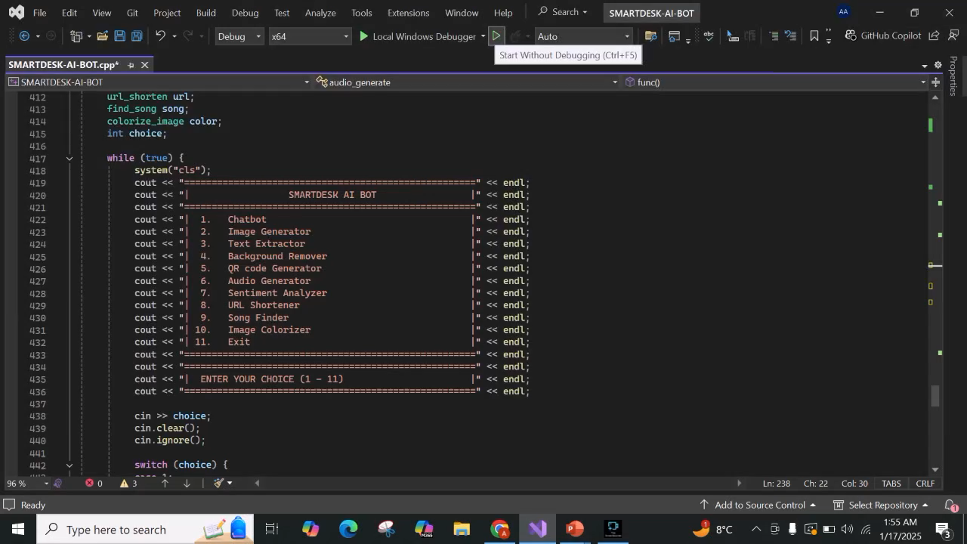

Slide 26
ANY QUESTIONS?

Slide 27
Thank You

